Slide 1

DATA TEAM: Group 14

Slide 2
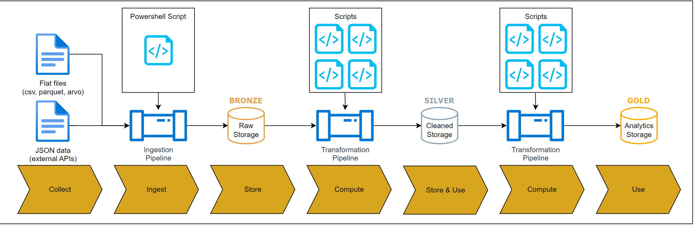
MEDALLION ARCHITECTURE
Notes:
KEEP

Slide 3
TECHNOLOGY OPTIONS
 | Feasibility | Overall
Option 1 [Recommended] | Bronze Layer: Ingest data through Azure Data Lake Storage Gen2 REST API. Silver Layer: Azure Function to transform and store data Gold Layer: Azure Function to transform and store data Orchestrate: data factory | Azure Data Storage: Unlimited - $0.334 per GB Azure Data Function: The first 400,000 GB/s of execution and 1,000,000 executions are free
Option 2 Azure Data Factory - Data Flows | Bronze Layer: Ingest data through Azure Data Lake Storage Gen2 REST API. Silver Layer: Azure Data Factory’s Data Flows to transform and store data Gold Layer: Azure Data Factory’s Data Flows to transform and store data | Cost: $0.46 per vCore-hour Estimated cost per run: ~ $0.31
Option 3 Azure Datafactory + Databricks [Recommended] | Bronze Layer: Ingest data through Azure Data Lake Storage Gen2 REST API. Silver Layer: Azure Databricks’ notebook to transform and store data Gold Layer: Azure Data Factory’s Data Flows to transform and store data | Cost: < $5/month for estimated usage Scalability Cost: Will increase quickly with larger data volume and increased process complexity Integration: Well with ML and other Azure services
Option 4 Azure Synapse | Bronze Layer: Ingest data through Azure Data Lake Storage Gen2 REST API. Silver Layer: Azure Synapse Analytics to transform and store data Gold Layer: Azure Synapse Analytics to transform and store data | Synapse Analytics Cost: $0.237 per vCore-hour Data Orchestration Cost: $1.531 per 1000 runs
Notes:
KEEP

Slide 4
 | Comparison | Ratings
Option 1 [Recommended] | Cost-effective: more cost-effective for small/medium workloads. Simplicity & Speed: Azure Functions are easier to set up and deploy → faster development time Scalability Limits: upper timeout durations of 10 minutes thus, issue when our dataset grows Cold Latency Starts: AF is serverless thus, will introduce latency due to cold starts → affect performance | Cost - ★★★★★ Utilisation - ★★★★☆ Scalability - ★★★☆☆ Capability - ★★★★☆
Option 2 Azure Data Factory - Data Flows [Dismissed] | Optimised for visual and low-code data transformations. Generally cost-effective for basic data transformation tasks. However, Will Struggle with complex logic and advanced data engineering tasks. Less efficient for scenarios requiring intricate data transformations or extensive custom logic. | Cost - ★★★★★ Utilisation - ★★★☆☆ Scalability - ★★★★☆ Capability - ★★★☆☆
Option 3 Azure Datafactory + Databricks [Recommended] | Offers superior scalability and versatility by integrating Azure Databricks, supporting complex data transformations and machine learning tasks within the same environment. Unlike other options, it handles both data engineering and ML workflows seamlessly, making it ideal for advanced processing. For low-scale, less complex, and small-volume projects, it's very cost-effective, with minimal costs, but as data volumes and complexity grow, costs can increase. | Cost - ★★★★☆ Utilisation - ★★★★☆ Scalability - ★★★★★ Capability - ★★★★★
Option 4 Azure Synapse | Scalability - Synapse can handle large volumes of data. The system will work well even with a large dataset. High quality data analytics - Synapse Analytics is a good choice for meaningful data transformations, data processing, and data analysis. It combines both SQL and Spark which allows us to choose between them at different instances. Expensive - Azure Synapse Analytics is generally expensive. Combining this with the costs of SQL pools, Spark pools, and Data Orchestration will make Synapse costly. Complexity - Synapse architecture consists of multiple layers and tools, Therefore, setting up Synapse can be challenging. Disproportionate- For the size of our dataset, Azure Synapse is excessive. Not all of the functions can be used which will lead to inefficiency. | Cost - ★★☆☆☆ Utilisation - ★★★☆☆ Scalability - ★★★★★ Capability - ★★★★★
Notes:
KEEP

Slide 5
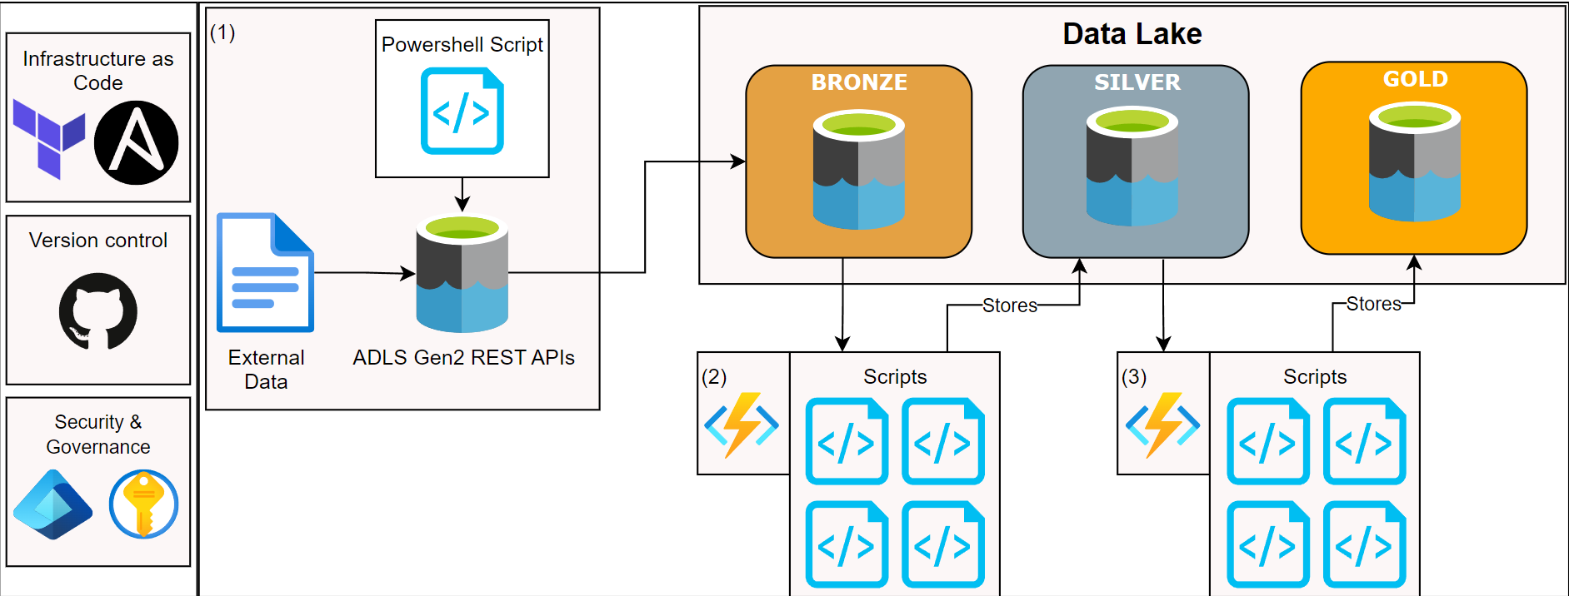
DESIGN OPTION 1
Notes:
KEEP

Slide 6
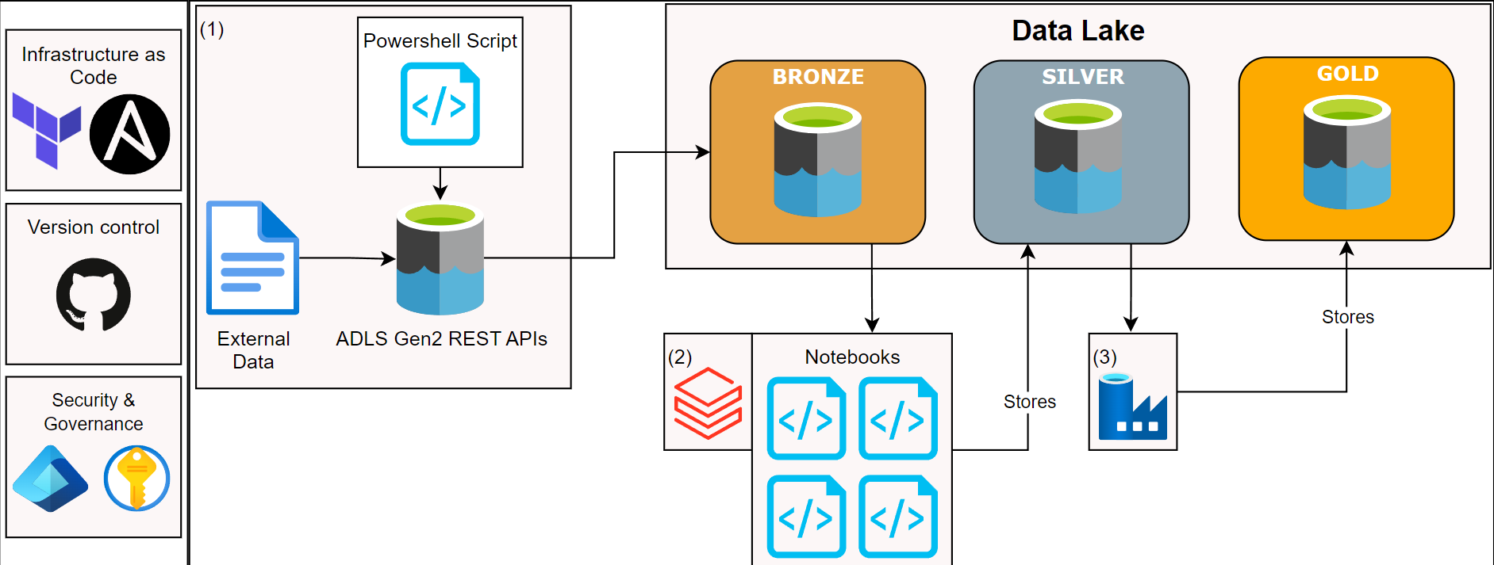
DESIGN OPTION 3
Notes:
KEEP

